Slide 1
Variable Width Tile Matrix Sets
Variable Tile Matrix Sets
  Part of 2D Tile Matrix Set Standard since first version
  2 examples in TileMatrixSet Register:
    GNOSISGlobalGrid
    CDB1GlobalGrid
  Concept of coalescing factor:
    Multiple tiles across latitude row become single tile, but with same number of pixels across (same tileWidth)

Slide 2
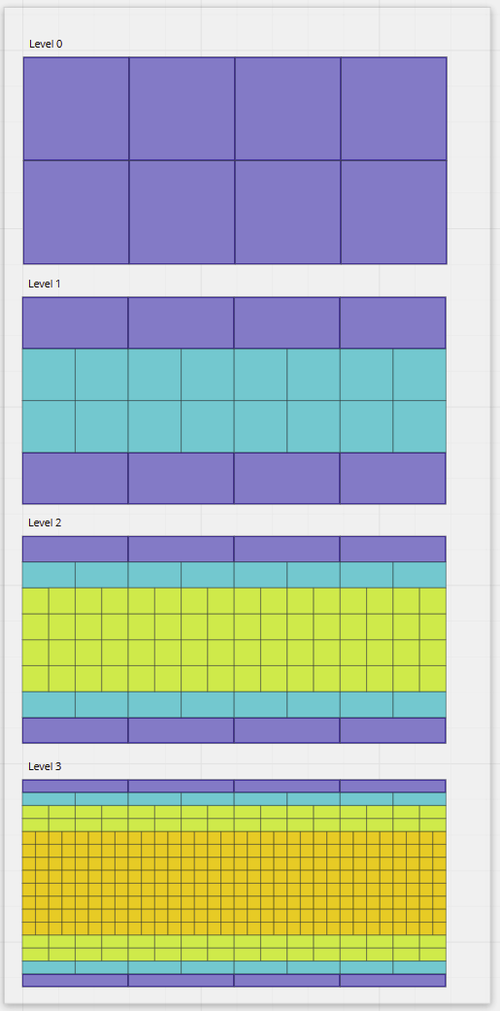
GNOSIS Global Grid

Slide 3
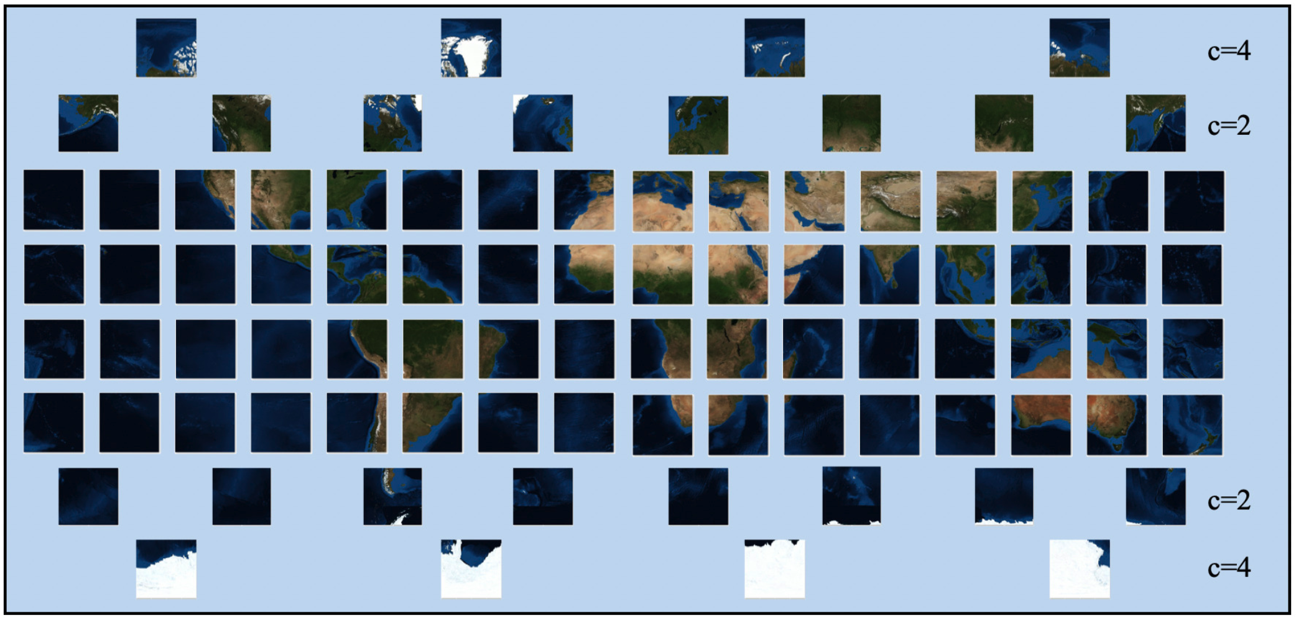
GNOSIS Global Grid

Slide 4
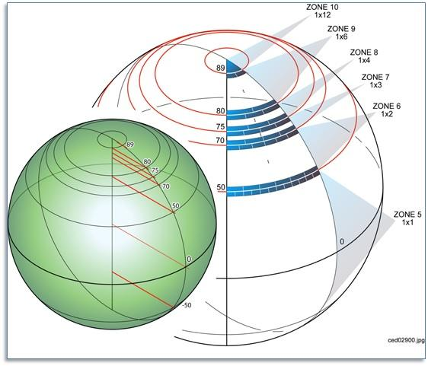
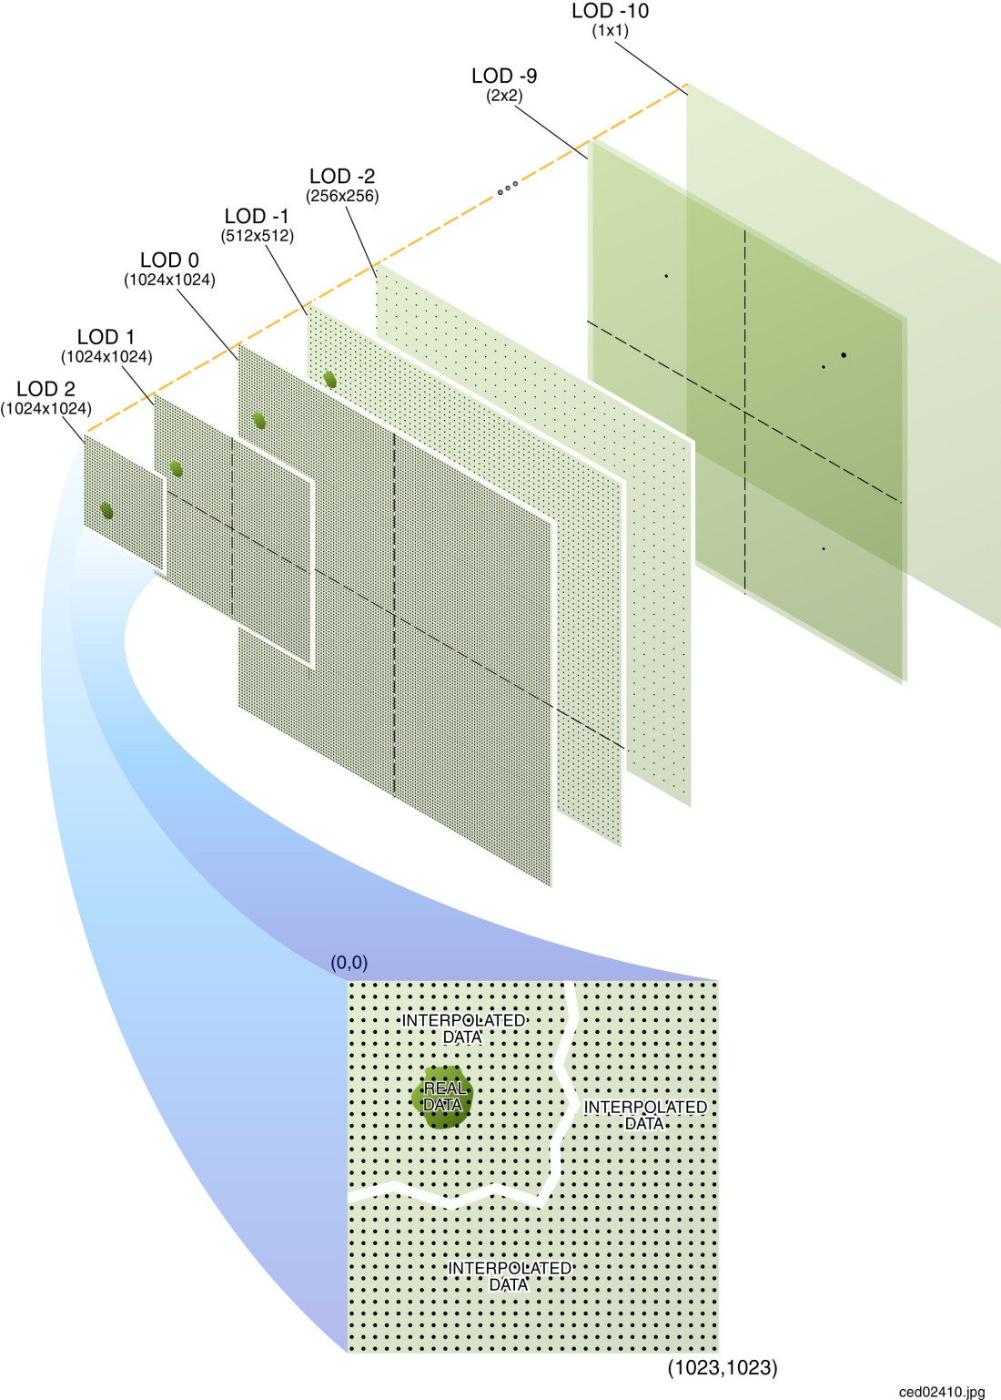
CDB 1 Global Grid

Slide 5
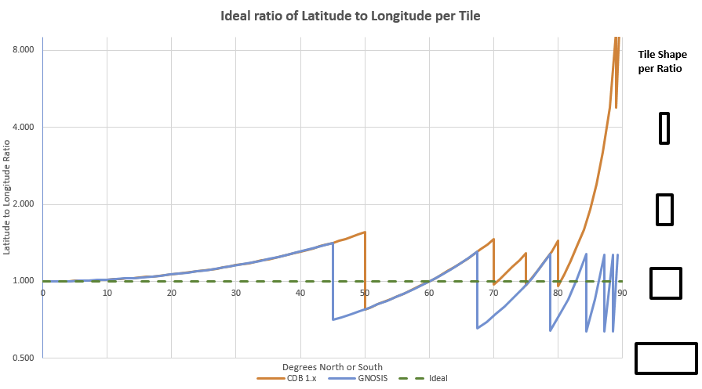
CDB 1 Global Grid

Slide 6
Objectives for the sprint
Work on producer / consumer of TileSets using Variable Width TMS
  e.g., test some initial support in GDAL

Slide 7
Community
500+ International Members
110+ Member Meetings
60+ Alliance and Liaison partners
50+ Standards Working Groups
45+ Domain Working Groups
25+ Years of Not for Profit Work
10+ Regional and Country Forums
Innovation
120+ Innovation Initiatives
380+ Technical reports
Quarterly Tech Trends monitoring
Standards
65+ Adopted Standards
300+ products with 1000+ certified implementations
1,700,000+ Operational Data Sets
Using OGC Standards
Contact info@ogc.org to schedule a meeting for an in-depth discussion with OGC staff and join our community today!
Notes:
If you have any questions, do not hesitate to reach out to OGC or schedule a follow-up. We’re working constantly to change the landscape of location information and want to help your organization get where it needs to go.

